Slide 1
The Scam-pocalypse
And how to Survive It

Slide 2
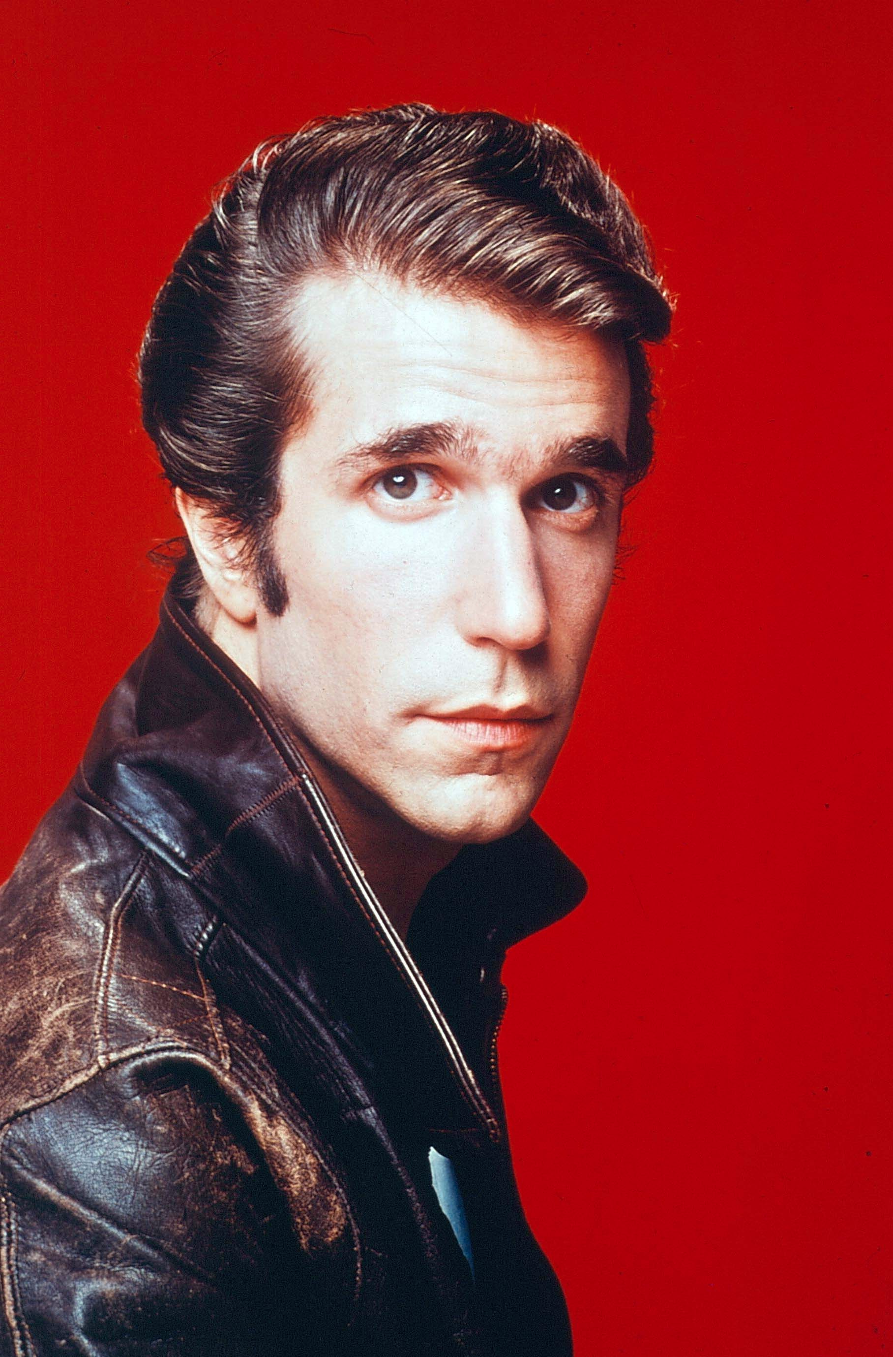
Financial Scam In The News
Did you hear Henry Winkler was arrested for a financial scam?

Slide 3
Things To Look Out For
Sense of Urgency
Appeal to emotions
Too good to be true

Slide 4
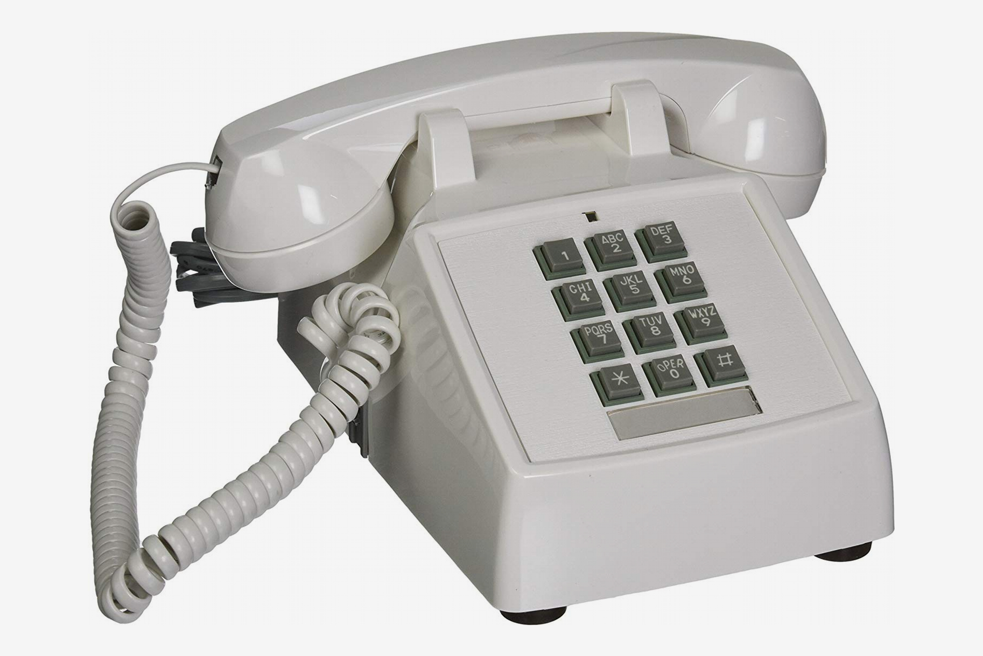
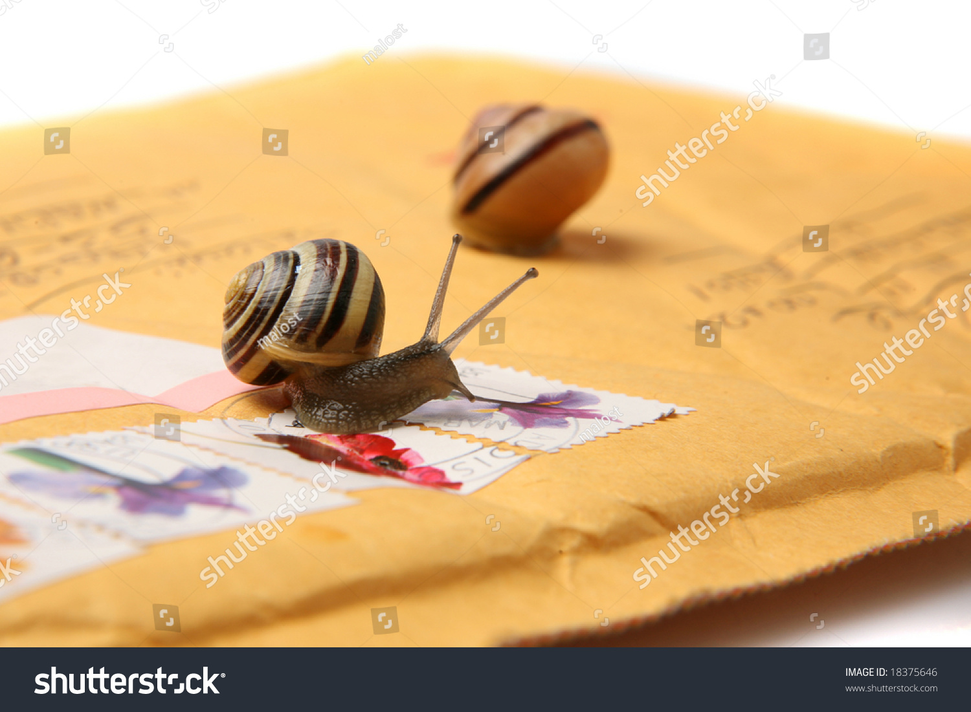
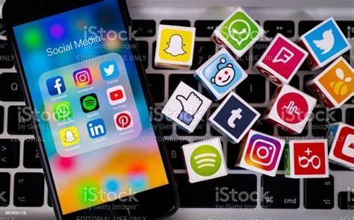
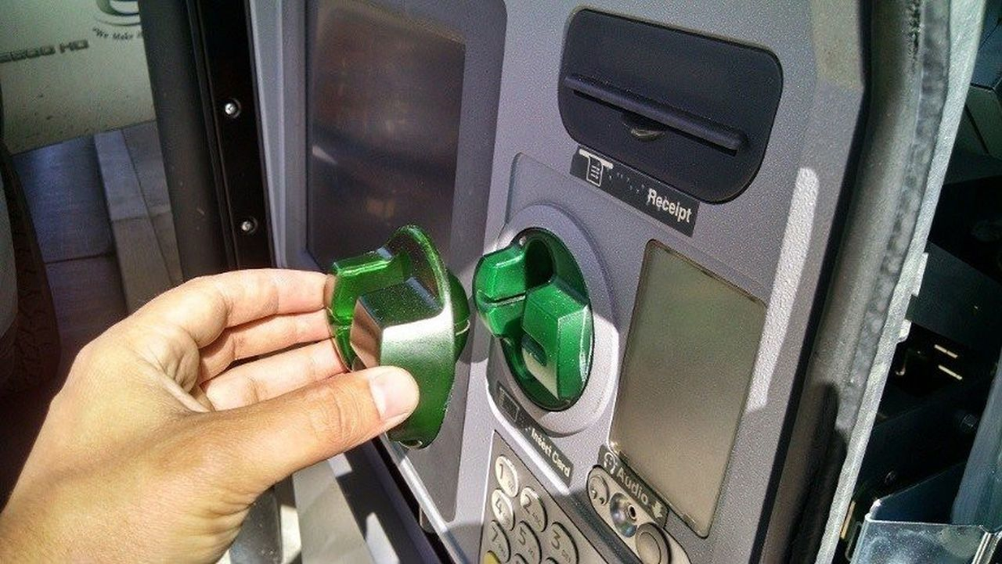
Scammers Love New Strategies
Phone Calls
Text Messages
Snail Mail
Emails
Social Media
Skimming Devices

Slide 5
Scam Phone Calls
Car Extended Warranty
Visa/Mastercard Services
Correctional Facilities

Slide 7
Email Scams
Key Things to Check and Watchout For:
SLAM
ender

Slide 9
Email Scams
Key Things to Check and Watchout For:
SLAM
ender
inks

Slide 10
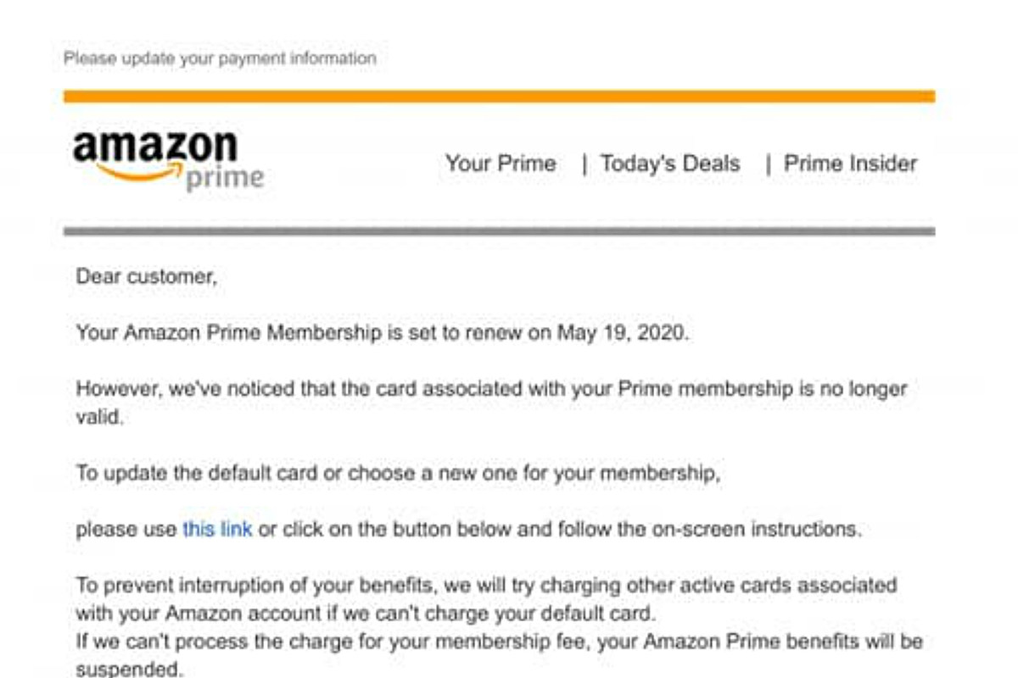

Slide 11
Email Scams
Key Things to Check and Watchout For:
SLAM
ender
inks
ttachments

Slide 12
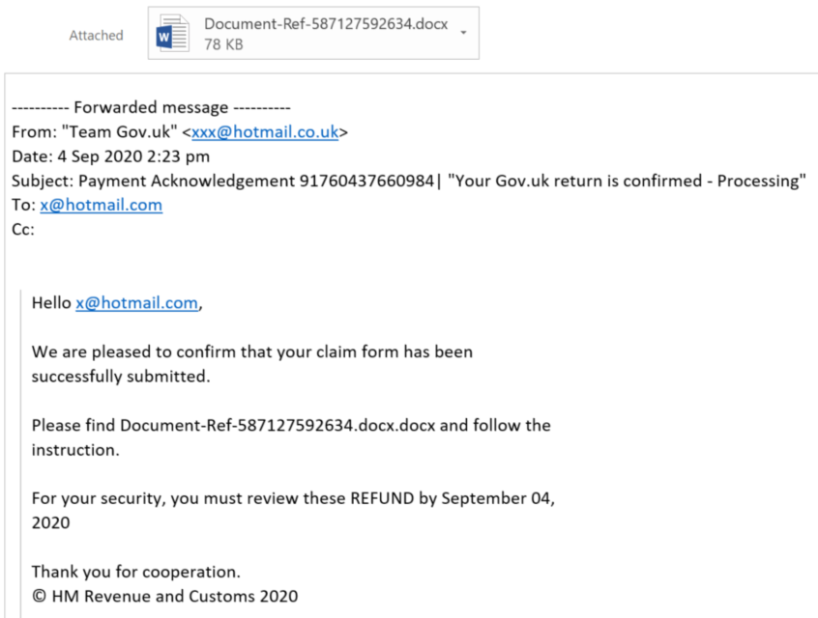

Slide 13
Email Scams
Key Things to Check and Watchout For:
SLAM
ender
inks
ttachments
essage

Slide 14
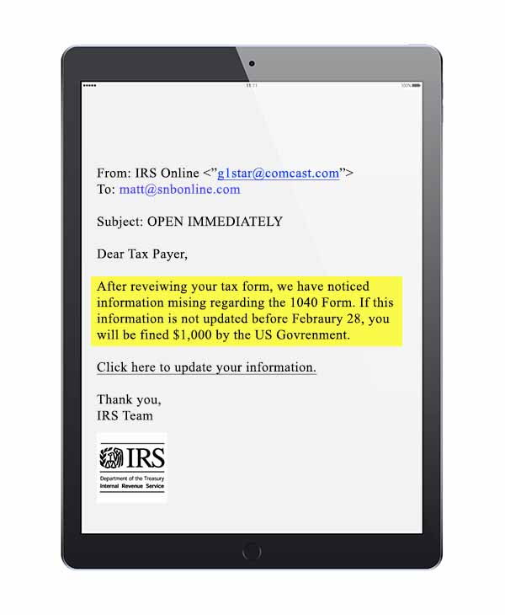

Slide 17
What do you call it when you fall for a pyramid scheme?

Slide 18
Text Message Scams
Apply the
SLAM
Method

Slide 23
Snail Mail

Slide 24
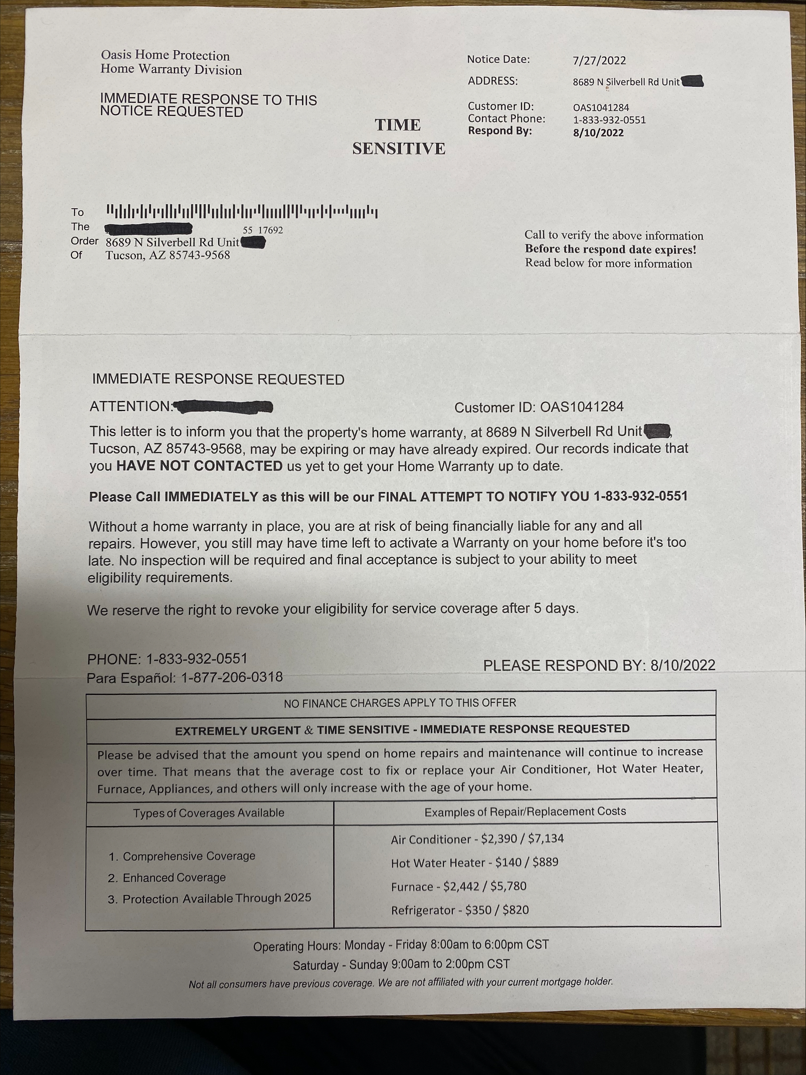

Slide 25
Social Media Scams
Watch Example of this common scam that has been occurring on many social media platforms

Slide 27
Credit Card Skimmers
Small
Quick to put in place
Disguised/camouflaged
Just give a little tug

Slide 28
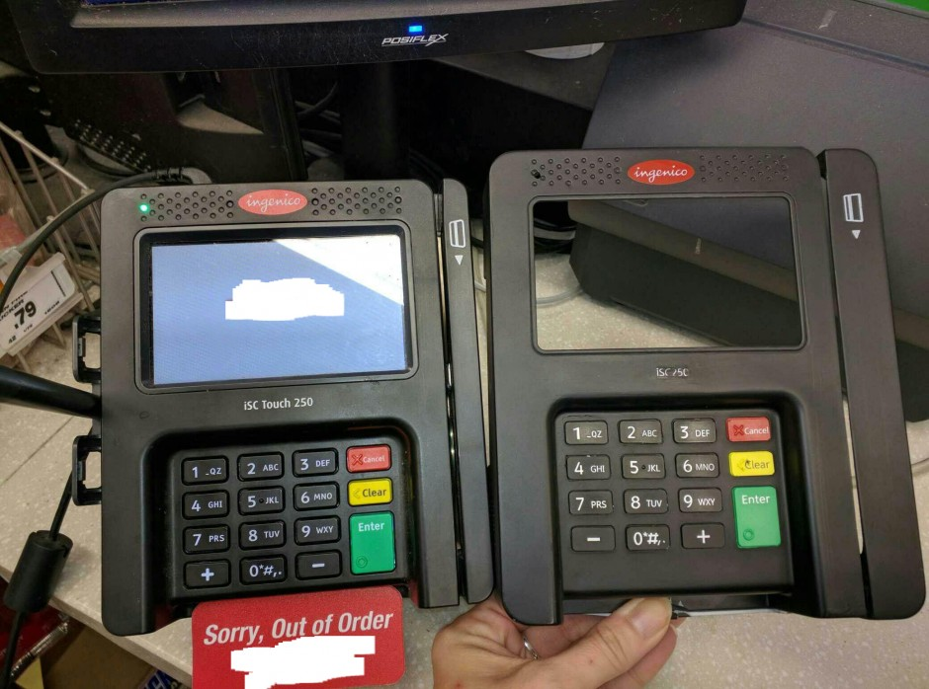
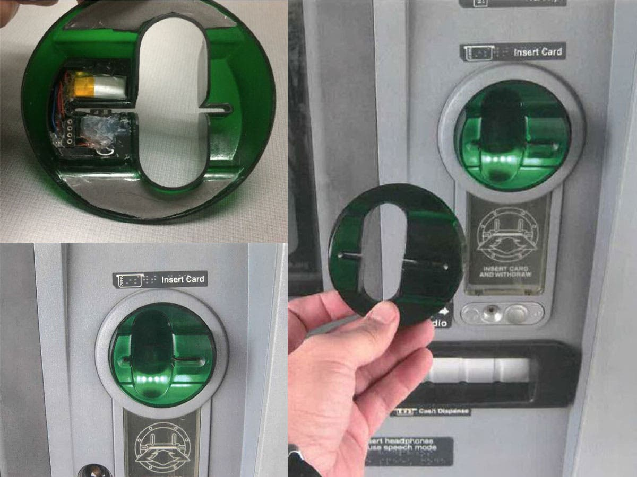
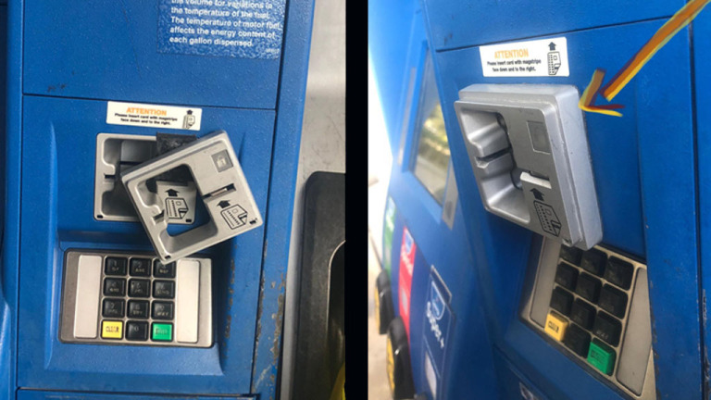

Slide 30
